Slide 1

Anonymity in the internet
Ярослав Кудяшев ИВТб-13-01

Slide 2


Anonymity in the Internet
In his speech, Tim Berners Lee speaks about several problems related to the Internet. In my opinion, the most interesting is the problem of anonymity on the Internet.

Slide 3
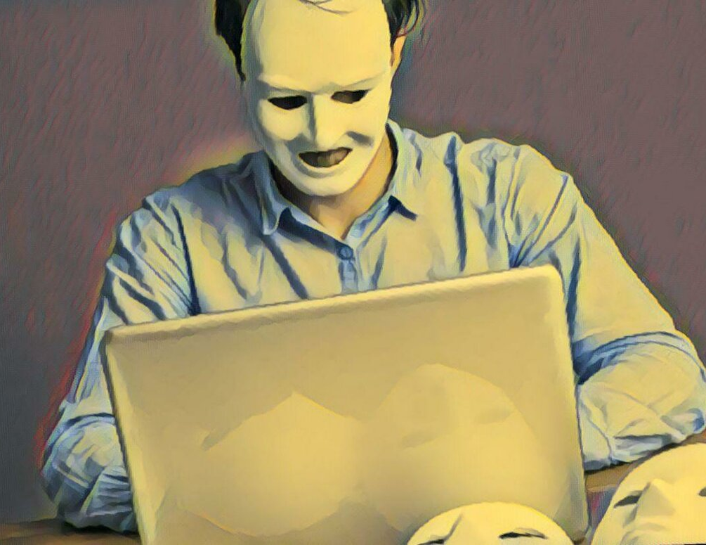
Is anonymity on the Internet a good or a bad thing?
First of all, I would like to say that anonymity has more disadvantages than advantages. A lot of negativity associated with insulting someone comes from anonymous users. People are afraid to show their negative attitude to any person they don’t like openly and insult him/her without harm to their own person. These people are called haters.

Slide 4

Do you agree with supporters that personal information about the users can be harmful for them and used by criminals and that people have right to hide their identities?
I agree with supporters that personal information about the users can be harmful to them and used by criminals. They can use the phone number and address in their crimes. Certainly, the users can hide their personal information but at the same time they can not publish it. As for me, I believe that real first and last name is enough for identification and I doubt that anyone can abuse me having only these data.

Slide 5
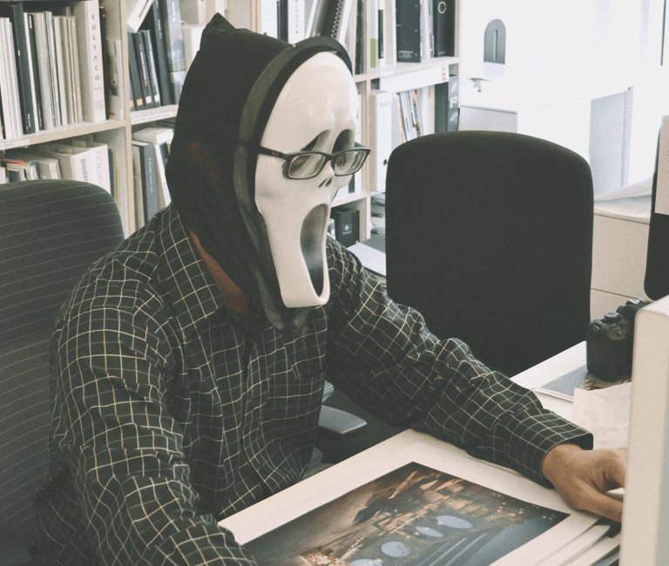
Do you agree with opponents that anonymity enables or encourages illegal or dangerous activity?
I agree with opponents that anonymity enables or encourages illegal or dangerous activity like terrorism or racism. But I am sure that anonymity can’t save such opponents because serious cases are already handled by law enforcement agencies. Each anonymous user can be found by IP address everywhere. For example, the online campaign «Immortal regiment» was recently hacked but, fortunately, the attackers were immediately detained.

Slide 6

Have you ever used anonymizers? Is it a trustworthy tool for hiding your privacy?
I also used anonymity but not for bad purposes. I asked questions on different forums not under my own name. It is easier for me because I don’t want people know who the author of these stupid and strange questions is. It was a good way to hide my identity. So, It’s the only advantage of anonymity.

Slide 7

Conclusion
Thanks for watching
In conclusion, I would like to say that anonymity on the Internet is important. You should use it correctly and not for bad purposes.

